Slide 1
DIGITAL FORENSICS & THREAT INTELLIGENCE
The Human Side of Cybersecurity
Understanding Social Engineering and Major Data Breaches.
STUDENT
ENROLLMENT
SUBJECT
INSTITUTION
Shubham makwana
241105060079
Cns
GMIU

Slide 2

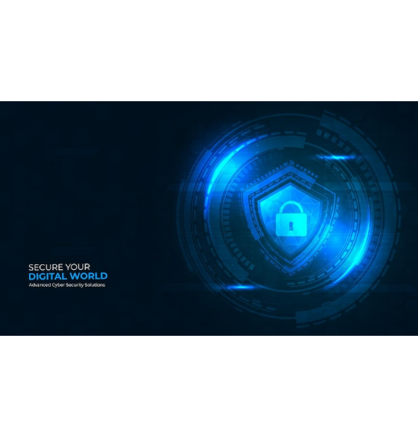



THE VULNERABILITY
Why Humans Are the Target
Technology is hard to hack; human psychology is easy to manipulate. Attackers exploit emotions rather than code.
Trust
Fear
Impersonating authority figures.
Threatening severe consequences.
Greed
Urgency
Promising financial rewards.
Demanding immediate action.

Slide 3
THREAT VECTORS
Common Social Engineering Techniques
Phishing
Spear Phishing
Pretexting
Deceptive mass emails mimicking trusted brands.
Highly targeted emails directed at specific individuals.
Fabricating a detailed story to manipulate targets.
Baiting
Tailgating
Offering attractive items containing malicious payloads.
Unauthorized physical entry by following authorized staff.

Slide 4
KILL CHAIN
Anatomy of a Social Engineering Attack
1
2
3
4
Research
The Hook
The Play
The Exit
Attacker gathers intelligence on the target victim.
Victim is engaged via deceptive pretext or urgency.
Victim clicks a link or hands over credentials.
Data is stolen and attacker covers their tracks.

Slide 5
CASE STUDIES
Major Real-World Data Breaches
2020
2013
2022
Twitter
Target Stores
Uber
Vector: Phone spear-phishing employees.
Vector: Phishing an external HVAC vendor.
Vector: MFA fatigue and WhatsApp pretexting.
Impact: High-profile VIP accounts hijacked.
Impact: Network accessed laterally via vendor.
Impact: Deep infrastructure compromise.
Result: Massive cryptocurrency scam.
Result: 40 million payment cards stolen.
Result: Internal databases and source code exposed.

Slide 6


HUMAN FIREWALL
Prevention Strategies
Building a resilient defense by combining technology with human awareness.
Enforce Multi-Factor Authentication globally.
Verify unusual requests out-of-band.
Conduct regular phishing simulations.
Block unauthorized physical tailgating.

Slide 7


OPERATIONAL SECURITY
Essential Do's and Don'ts
DO
DON'T
Verify sender identities meticulously.
Provide credentials via email or phone.
Hover over links to check actual URLs.
Open unexpected email attachments.
Report suspicious activity immediately.
Connect found USB drives to networks.
Challenge unknown persons in secure areas.
Bypass security controls for convenience.

Slide 8

You Are the First Line of Defense.
Thank you. Questions & Discussion.

Slide 9

Image Sources
https://img.magnific.com/free-vector/cyber-security-protection-banner-with-digital-shield-lock-futuristic-interface_120329-7689.jpg?semt=ais_hybrid&w=740&q=80
Source: www.magnific.com

